Slide 1


Developing Power BI for Dataverse + PowerApps, and Dynamics 365
Scott Sewell Principal Program Manager Power BI CAT team
/in/mscottsewell
@ScottSewell

Slide 2

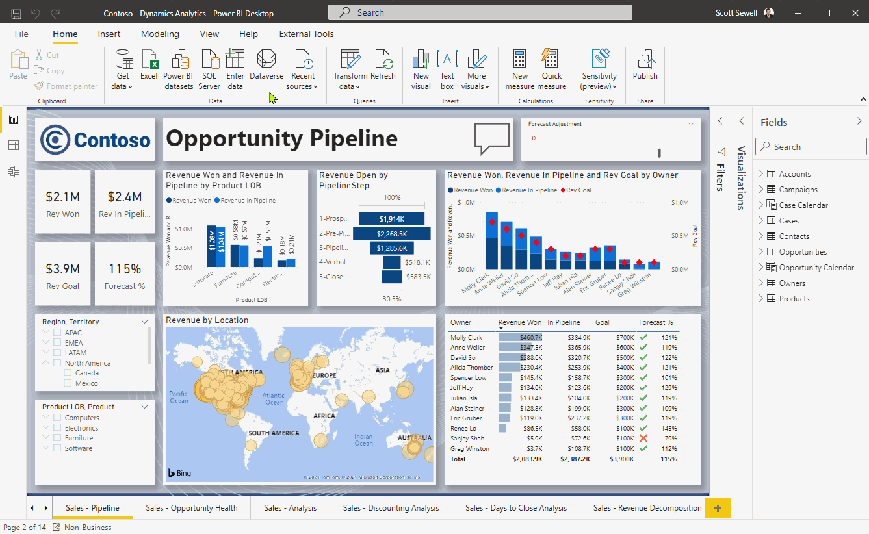
Vectors
Dataverse in Power BI
Power BI in Apps
Apps in Power BI
Power Automate in Power BI

Slide 3
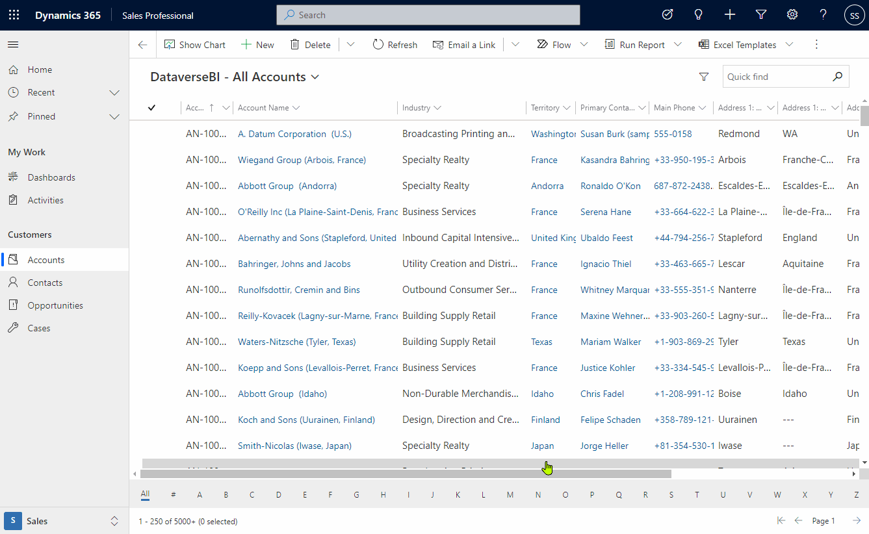
Vectors
Dataverse in Power BI
Power BI in Apps
Apps in Power BI
Power Automate in Power BI

Slide 4
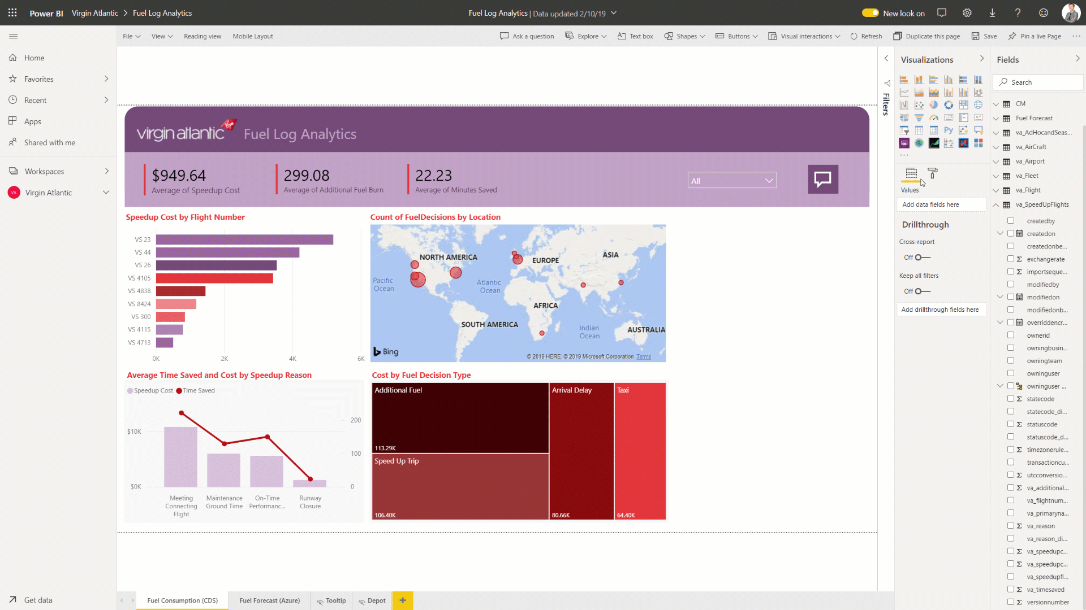
Vectors
Dataverse in Power BI
Power BI in Apps
Apps in Power BI
Power Automate in Power BI

Slide 5
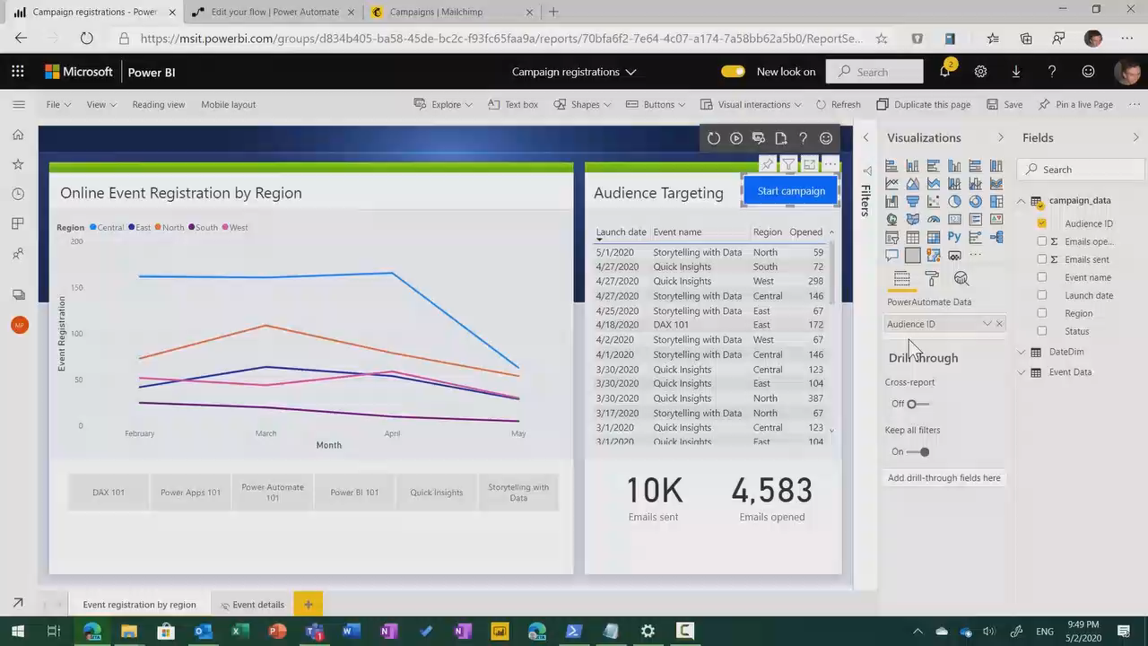
Vectors
Dataverse in Power BI
Power BI in Apps
Apps in Power BI
Power Automate in Power BI

Slide 6
Demo
Power BI in a Model-Driven Power App

Slide 7
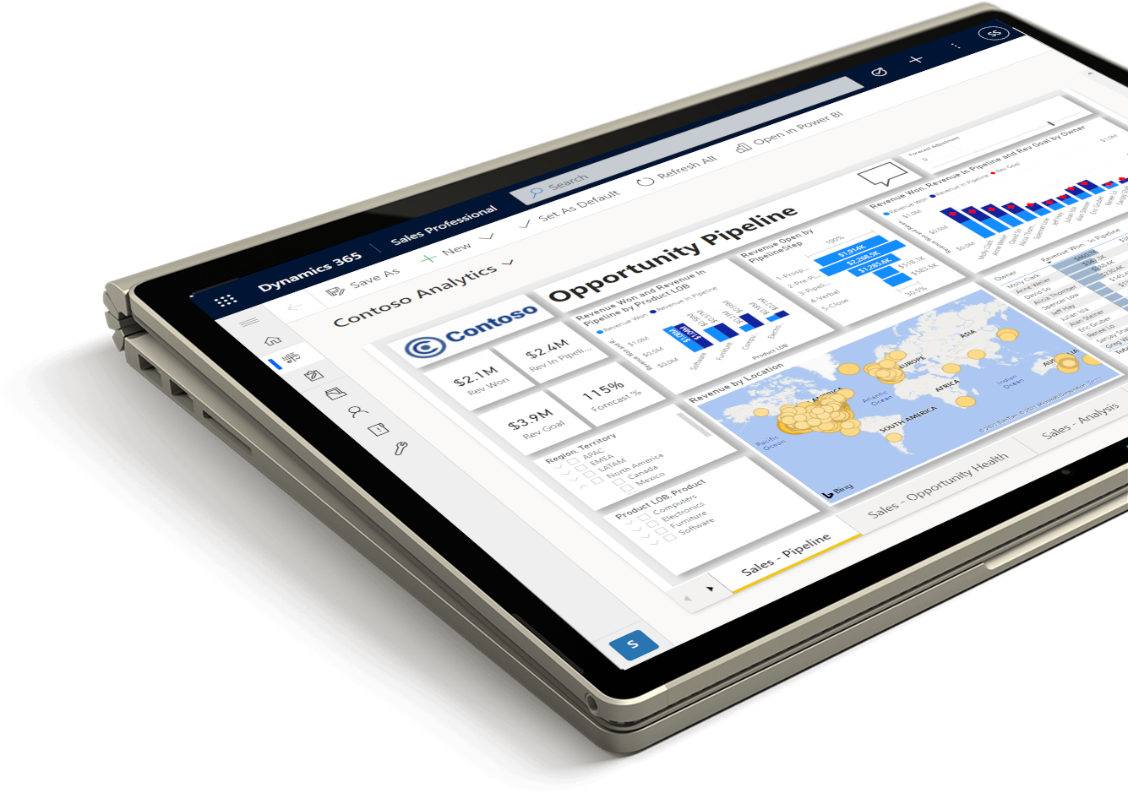

Power BI + Dataverse
Power BI Monthly Active Usage
Empower Business Decision makers and app users
Data-Driven Culture
Every Decision
Any Scale
5TH
Year of
TRIPLE DIGIT PAID
Usage Growth
150k+
Organizations
June, 30 - 2020

Slide 8
Fast Facts on Connectivity between Power BI and Dataverse
More Flexibility / More Value

Slide 9
Dataverse to Power BI Decision Support
Dataverse DirectQuery
Dataverse Import Mode
Azure Synapse Link
Basic Options
Report Categories
Report User Personas
Security Implications
Performance Impacts
Data Volume

Slide 10
Dataverse to Power BI Decision Support
Dataverse DirectQuery
Individual user’s own data – near real-time refresh
Targeted datasets pulled from enormous databases
Dataverse Import Mode
Scheduled refreshes of medium-sized datasets
Azure Synapse Link
Enterprise-Scale data source for reporting
Basic Options
Report Categories
Report User Personas
Security Implications
Performance Impacts
Data Volume

Slide 11
Dataverse to Power BI Decision Support
Operational users
Dataverse DirectQuery
Groups, or Users with wide visibility
Dataverse Import Mode
Enterprise level capabilities
Azure Synapse Link
Basic Options
Report Categories
Report User Personas
Security Implications
Performance Impacts
Data Volume

Slide 12
Dataverse to Power BI Decision Support
Trimmed with Dataverse Security
Dataverse DirectQuery
Security handled Outside Dataverse
Dataverse Import Mode
Azure Synapse Link
Basic Options
Report Categories
Report User Personas
Security Implications
Performance Impacts
Data Volume

Slide 13
Dataverse to Power BI Decision Support
Refreshed on-demand
Dataverse DirectQuery
Highly Responsive Report UX
Dataverse Import Mode
Azure Synapse Link
Basic Options
Report Categories
Report User Personas
Security Implications
Performance Impacts
Data Volume

Slide 14
Dataverse to Power BI Decision Support
Under ~100K records* in result set
Dataverse DirectQuery
Dataverse Import Mode
A few hundred thousand records*
Power BI Premium with Incremental Refresh
Larger datasets
Azure Synapse Link
Basic Options
Report Categories
Report User Personas
Security Implications
Performance Impacts
Data Volume
*There is an 80-MB maximum size & a 2-minute timeout for individual query results returned from the Dataverse TDS/SQL endpoint.

Slide 15
Best practices for DirectQuery of Dataverse in Power BI

Slide 16

DirectQuery Hints
Stay focused on use case
Embrace a Star Schema
Minimize query columns
Leverage the Query Editor
Avoid large blocks of text
Minimize optionset labels
Consider dual-mode dims
Don’t forget the checkbox
More information:
What topic area is this report supporting?
Who is the audience of this report?
What question is the report trying to answer?
What’s the MVD - Minimum Viable Dataset?

Slide 17


DirectQuery Hints
Stay focused on use case
Embrace a Star Schema
Minimize query columns
Leverage the Query Editor
Avoid large blocks of text
Minimize optionset labels
Consider dual-mode dims
Don’t forget the checkbox
More information:

Slide 18
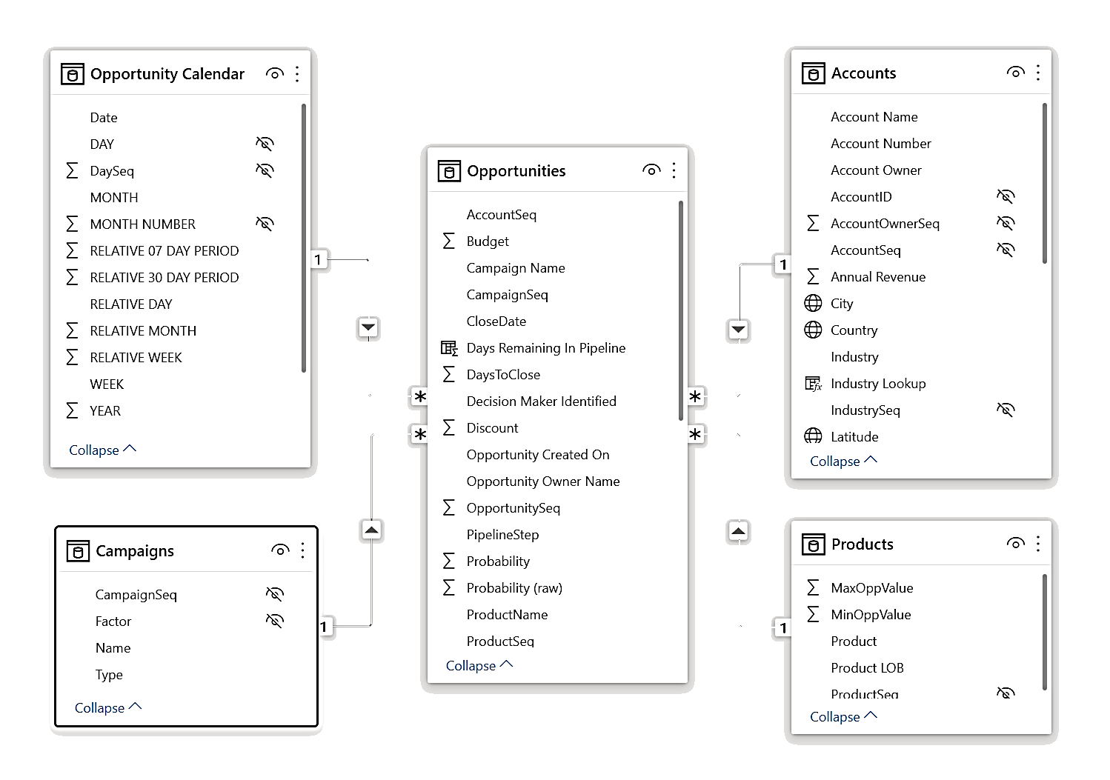





DirectQuery Hints
Stay focused on use case
Embrace a Star Schema
Minimize query columns
Leverage the Query Editor
Avoid large blocks of text
Minimize optionset labels
Consider dual-mode dims
Don’t forget the checkbox
More information:
Dimension
Dimension
FACT
Dimension
Dimension
Understand star schema and the importance for Power BI - Power BI | Microsoft Docs

Slide 19
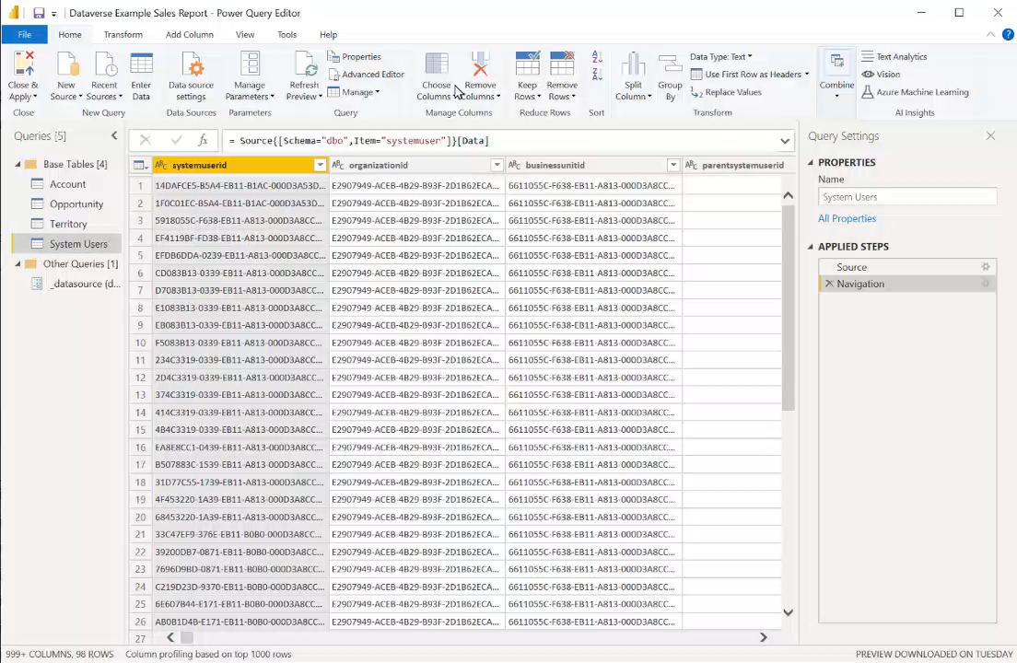
DirectQuery Hints
Stay focused on use case
Embrace a Star Schema
Minimize query columns
Leverage the Query Editor
Avoid large blocks of text
Minimize optionset labels
Consider dual-mode dims
Don’t forget the checkbox
More information:
Laura-GB/DataversePowerQueryHelper: Tools built using Excel VBA to help build Power Query code to access a Dataverse environment (github.com)

Slide 20
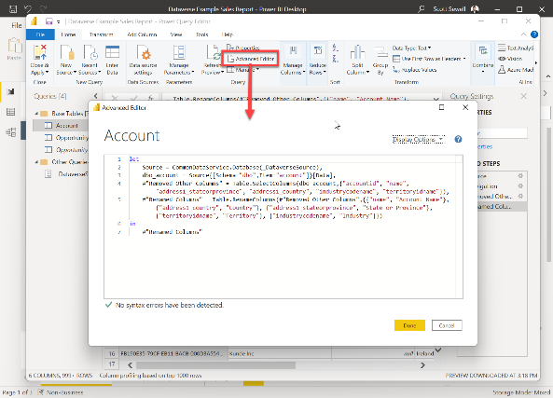
DirectQuery Hints
Stay focused on use case
Embrace a Star Schema
Minimize query columns
Leverage the Query Editor
Avoid large blocks of text
Minimize optionset labels
Consider dual-mode dims
Don’t forget the checkbox
More information:
For large Dataverse tables, start with a “blank” query in the Power Query Editor and use a simplified starter query to avoid timeouts common with large datasets. Example: let
Source = CommonDataService.Database("myenvironment.crm.dynamics.com"),
source_table = Source{[Schema="dbo",Item="account"]}[Data],
#"Removed Other Columns" = Table.SelectColumns(source_table,{"accountid", "name"})
in
#"Removed Other Columns" (This is useful for both DirectQuery and Import mode)

Slide 21
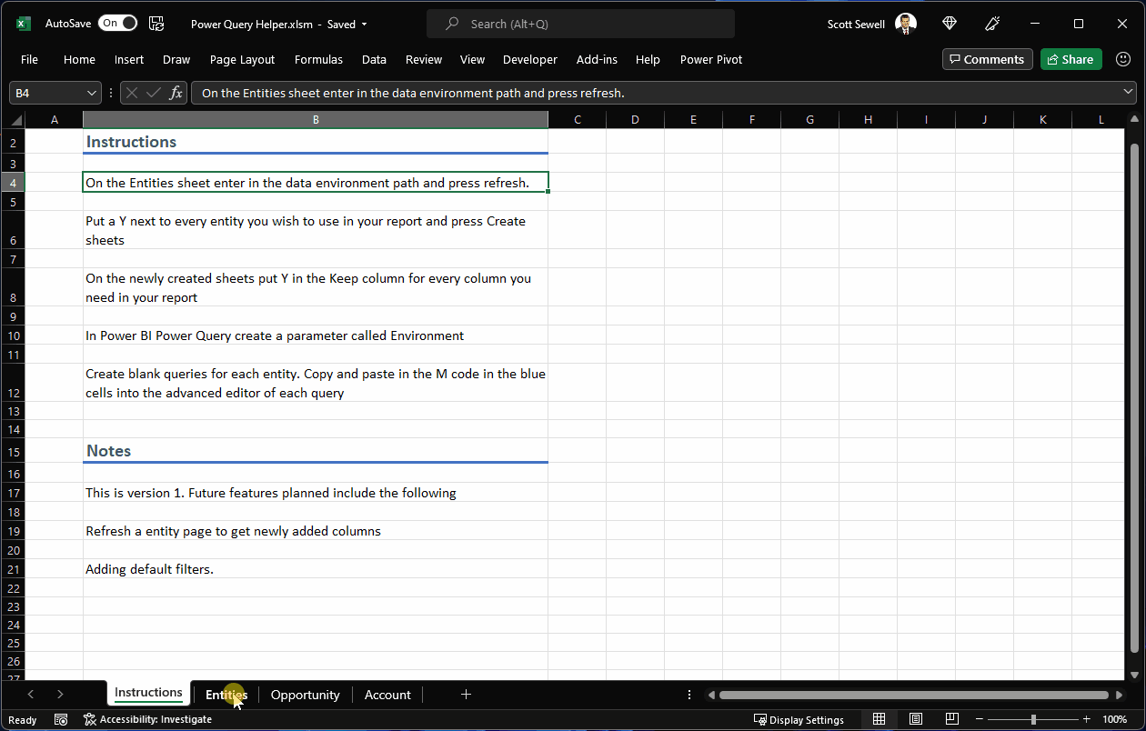
DirectQuery Hints
Bonus: Excel tool for Building Power Queries on Dataverse by: Laura Graham-Brown (@Laura_GB)
https://github.com/Laura-GB/DataversePowerQueryHelper
Stay focused on use case
Embrace a Star Schema
Minimize query columns
Leverage the Query Editor
Avoid large blocks of text
Minimize optionset labels
Consider dual-mode dims
Don’t forget the checkbox
More information:

Slide 22
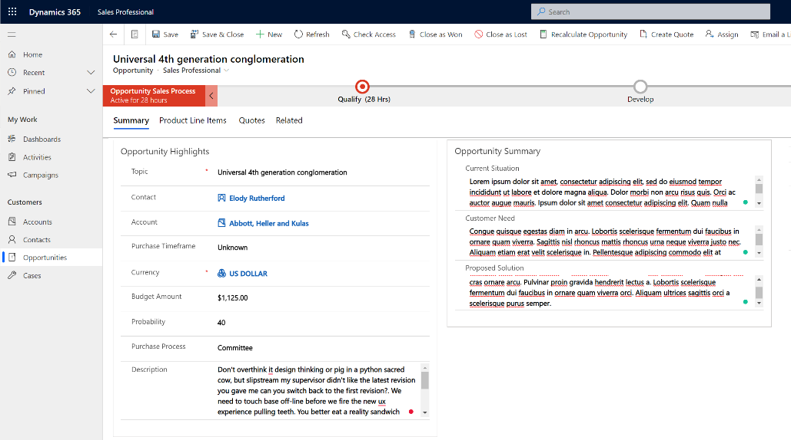


DirectQuery Hints
Stay focused on use case
Embrace a Star Schema
Minimize query columns
Leverage the Query Editor
Avoid large blocks of text
Minimize optionset labels
Consider dual-mode dims
Don’t forget the checkbox
More information:

Slide 23
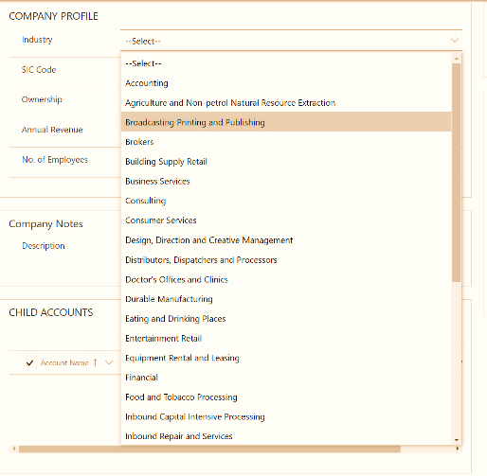

DirectQuery Hints
Stay focused on use case
Embrace a Star Schema
Minimize query columns
Leverage the Query Editor
Avoid large blocks of text
Minimize optionset labels
Consider dual-mode dims
Don’t forget the checkbox
More information:
Whenever possible, filter the dataset on the numeric value of an optionset, rather than the string.
Normally a few optionsets are fine, but if there are a dozen or more being pulled in the query, consider returning only the integer value from Dataverse and using a calculated field to apply the label inside Power BI. – This improves speed and reduces the overall size of the query results.

Slide 24
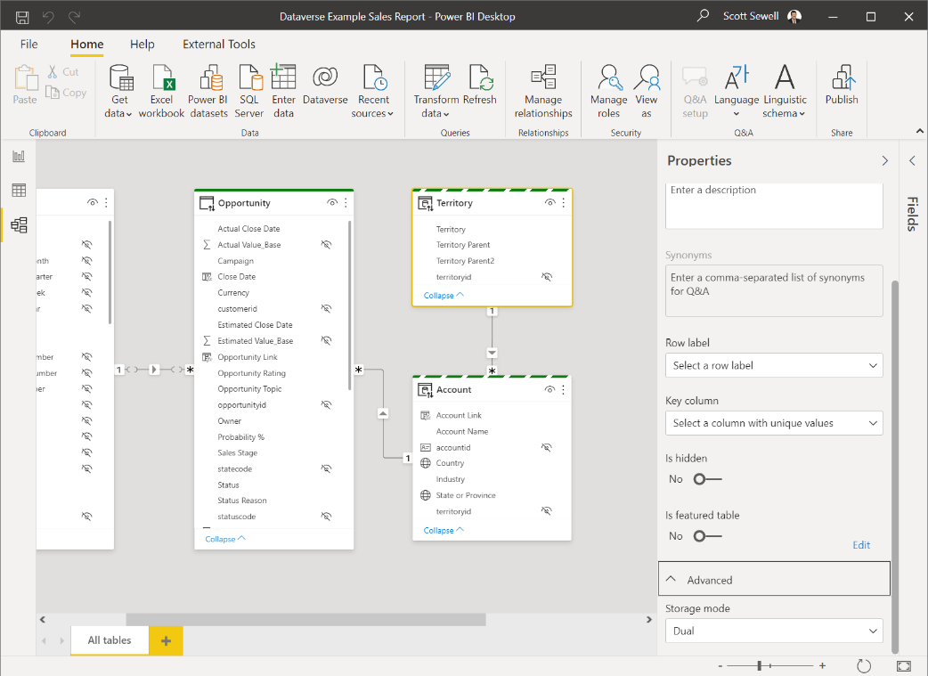
DirectQuery Hints
Stay focused on use case
Embrace a Star Schema
Minimize query columns
Leverage the Query Editor
Avoid large blocks of text
Minimize optionset labels
Consider dual-mode dims
Don’t forget the checkbox
More information:

Slide 25
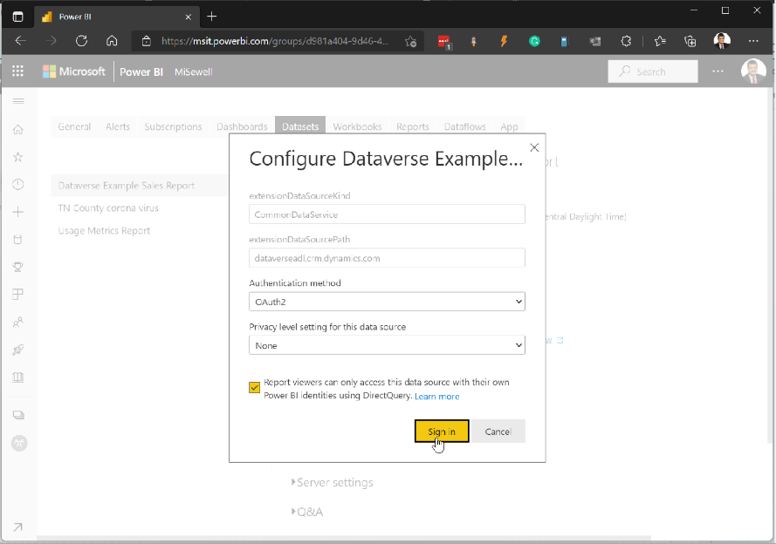
DirectQuery Hints
Stay focused on use case
Embrace a Star Schema
Minimize query columns
Leverage the Query Editor
Avoid large blocks of text
Minimize optionset labels
Consider dual-mode dims
Don’t forget the checkbox
More information:
After Publishing the Report, you’ll need to set up the credentials for the dataset.
Be sure to click the checkbox to ensure report viewers will see the report filtered to the data they have permission to see within Dataverse.

Slide 26
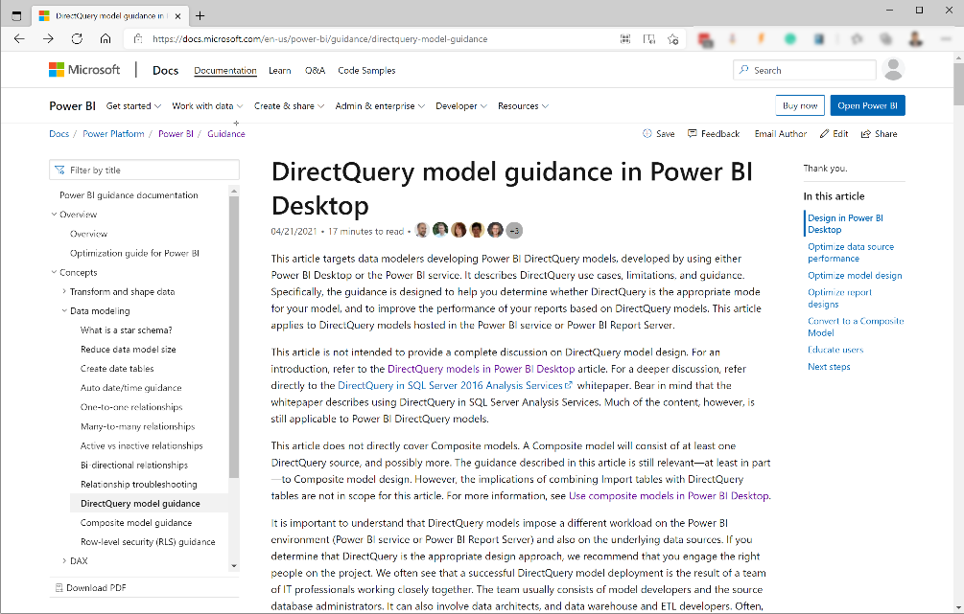
DirectQuery Hints
Stay focused on use case
Embrace a Star Schema
Minimize query columns
Leverage the Query Editor
Avoid large blocks of text
Minimize optionset labels
Consider dual-mode dims
Don’t forget the checkbox
More information:
DirectQuery model guidance in Power BI Desktop - Power BI | Microsoft Docs
DirectQuery model troubleshooting in Power BI Desktop - Power BI | Microsoft Docs

Slide 27
Resources
Power BI guidance documentation

Slide 28
Thank You!

